Slide 1
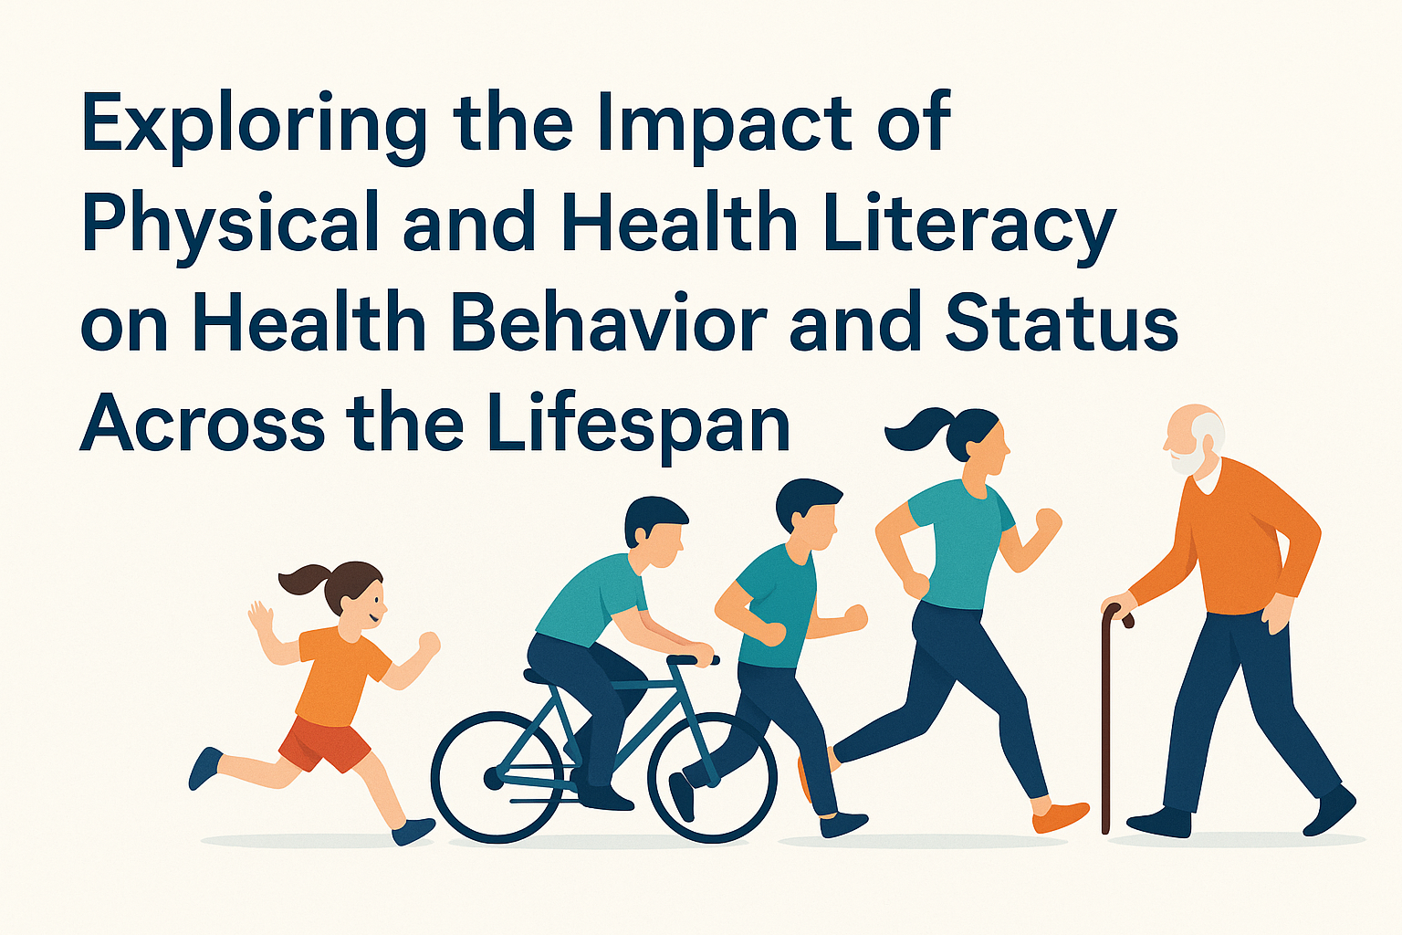
23rd Conference of the Montenegrin Sports Academy – Podgorica Sports Science, Medicine & Health Forum 2025
KIFST TEAM

Slide 2
INTRODUCING KEY TERMS

Slide 3
PHYSICAL LITERACY
Physical literacy is the motivation, confidence, physical competence, knowledge, and understanding to value and take responsibility for engaging in physical activities for life.
Importance:
Encourages lifelong physical activity
Associated with better motor skills and movement confidence
Linked to improved physical and mental health outcomes
Supports positive social interactions and teamwork

Slide 4
HEALTH LITERACY
Health literacy is the ability to access, understand, appraise, and apply health-related information to make appropriate health decisions in everyday life.
Importance:
Empowers individuals to manage their own health
Associated with better medication adherence, preventive behaviors, and chronic disease management
Reduces health disparities
Enhances communication with health professionals

Slide 5
PHYSICAL ACTIVITY
Physical activity is any bodily movement produced by skeletal muscles that results in energy expenditure, including exercise, sports, play, and daily tasks.
Importance:
Prevents and manages noncommunicable diseases (e.g., heart disease, diabetes)
Supports healthy growth and development in youth
Improves mental health and cognitive function
Reduces premature mortality

Slide 6
PHYSICAL FITNESS
Physical fitness refers to the ability to carry out daily tasks with vigor and alertness, without undue fatigue, and with ample energy to enjoy leisure-time pursuits and respond to emergencies. It includes components such as cardiovascular endurance, muscular strength, flexibility, and body composition.
Importance:
Enhances functional ability and independence
Predicts health status and disease risk
Contributes to higher quality of life
Positively influences academic and work performance

Slide 7
HEALTH STATUS
Health status refers to the overall physical, mental, and social well-being of an individual, typically measured through self-report, clinical indicators, or health-related quality of life metrics.
Importance:
Reflects the effectiveness of health behaviors and systems
Drives health policy and resource allocation
Affects quality of life and economic productivity
ntegrates outcomes from physical activity, literacy, and fitness levels

Slide 8
RATIONALE
We often assume that higher literacy leads to healthier lives, but is this truly the case?
Same for physical literacy…

Slide 9
PROJECT(S) AIMS
To identify levels of physical literacy, health literacy, physical activity, physical fitness and health status of preadolescents, adolescents, adults and older adults
To examine the interrelationship between all parameters
To examine how physical and health literacies impact health behaviors and health outcomes across age groups

Slide 10
WHY ALL AGE GROUPS??

Slide 11
WHAT HAS BEEN DONE AND WHAT IS ONGOING?

Slide 12
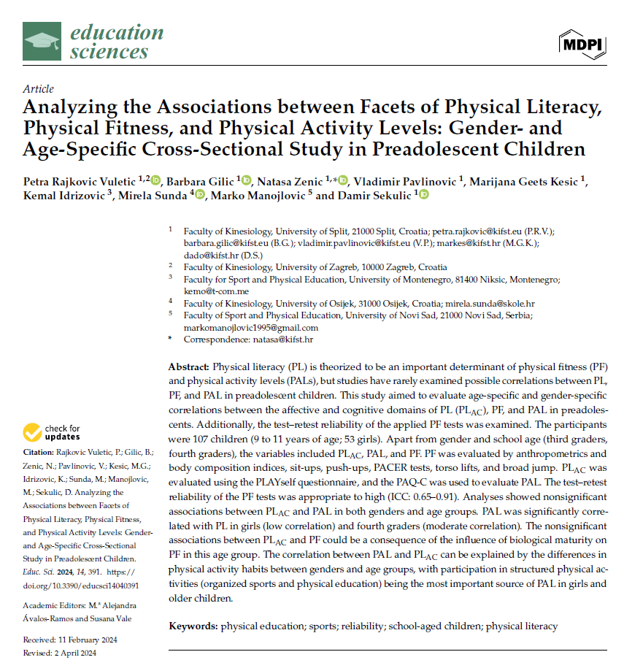
PREADOLESCENTS

Slide 13
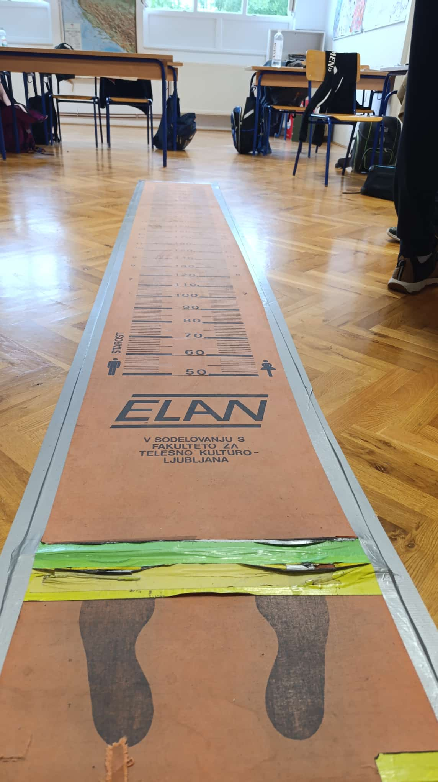
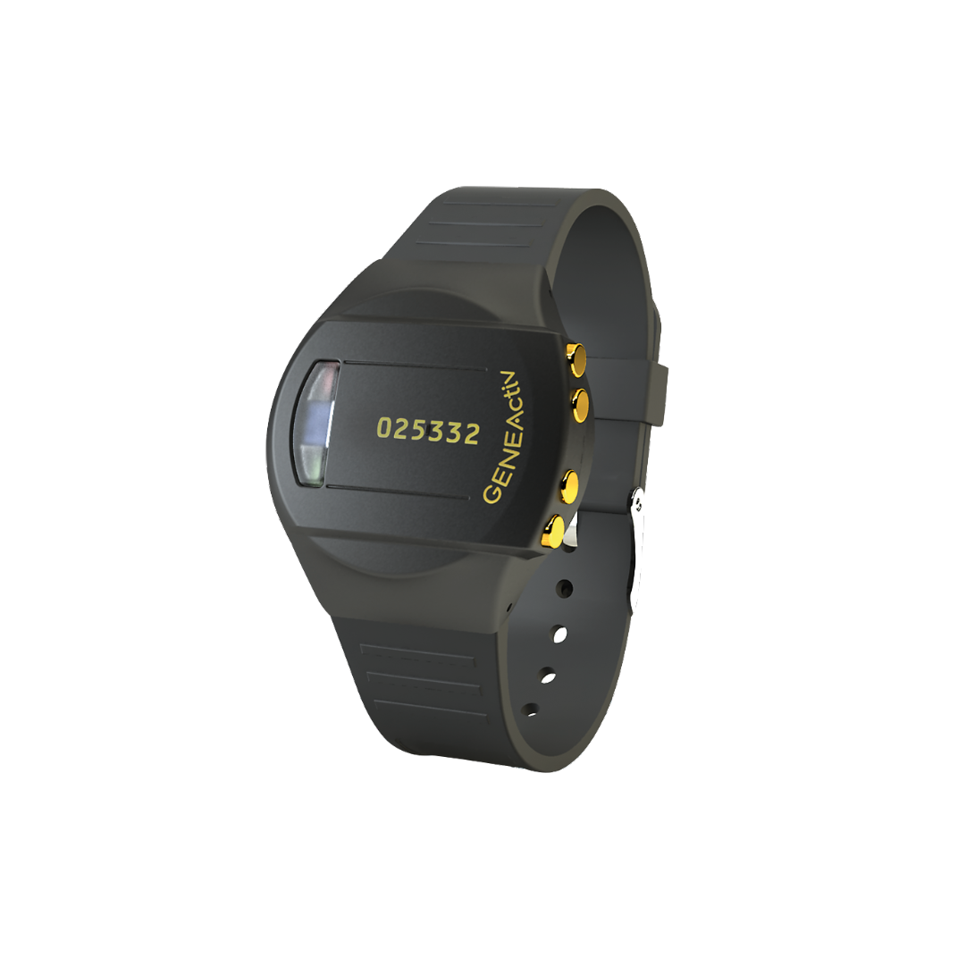
PREADOLESCENTS
ONGOING: Evaluating the effectivenes of PL education on improving PL, PA, PF…

Slide 14
ADOLESCENTS
Physical activity
Physical fitness
Literacies
Status, interconnections
Effectivenes of PL intervention

Slide 15
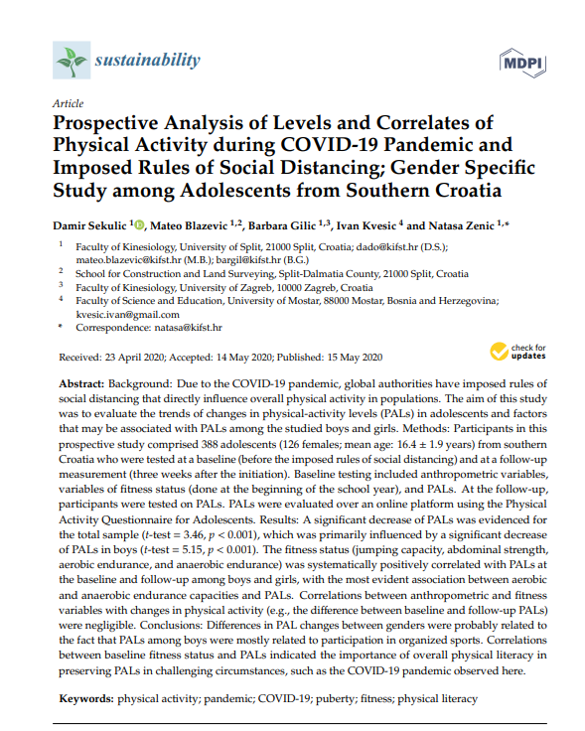
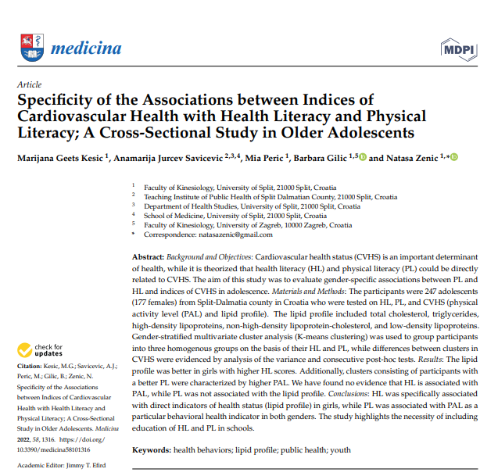
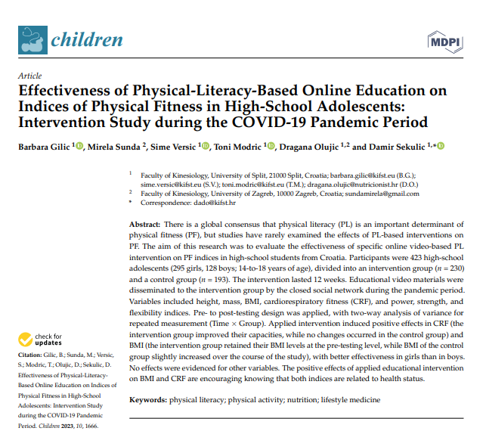
ADOLESCENTS

Slide 16
ADULTS

Slide 17
ADULTS

Slide 18
OLDER ADULTS

Slide 19
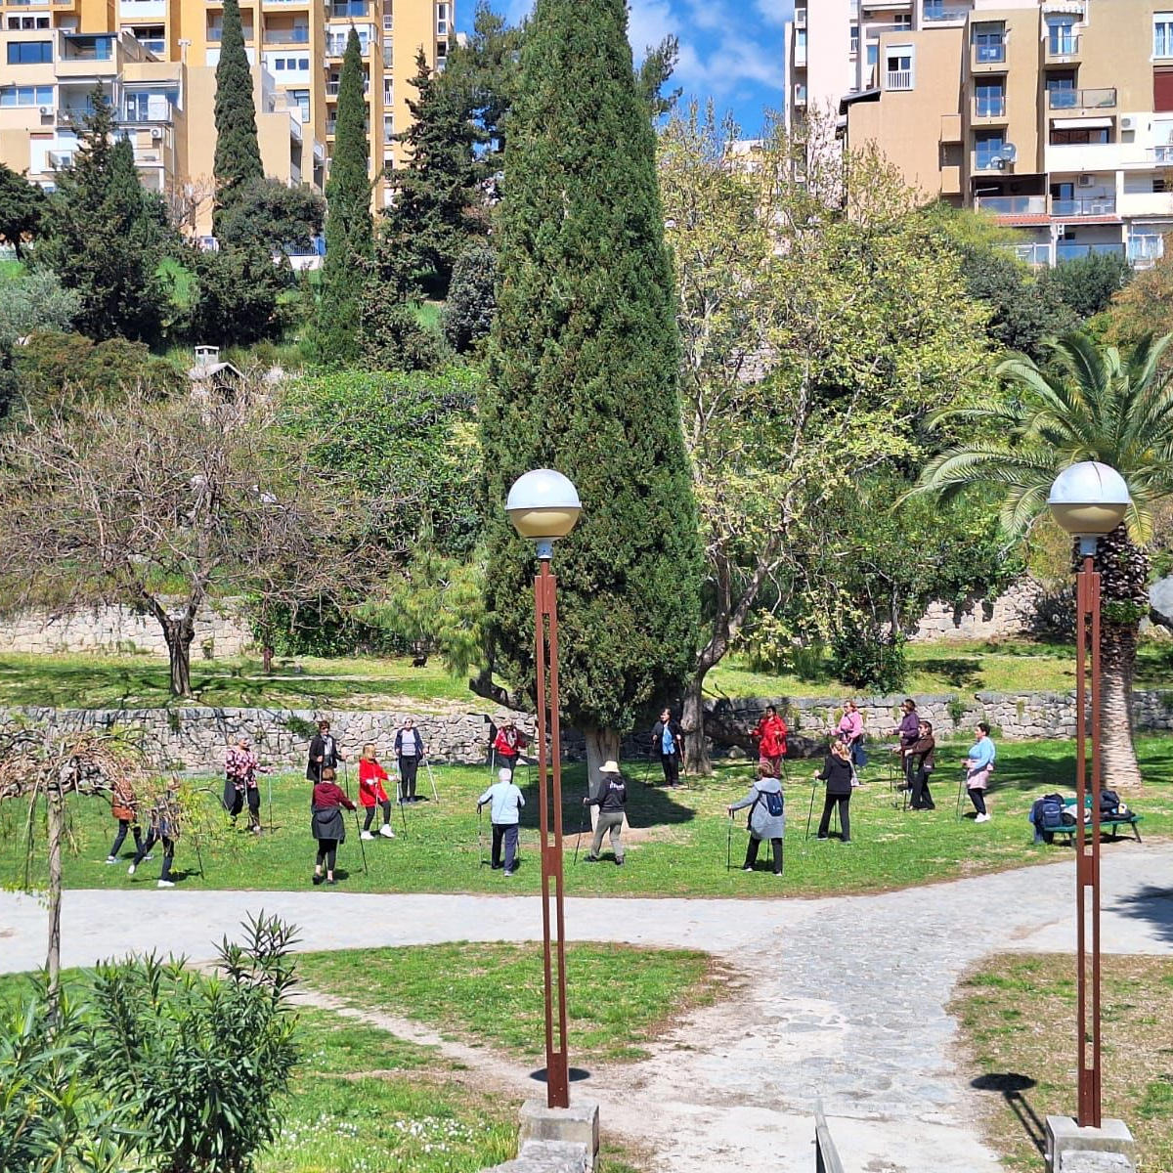
OLDER ADULTS
Ongoing: Evaluating the effectiveness of exercise protocol on physical literacy, health literacy, physical activity, physical fitness and health status

Slide 21
What’s next?

Slide 22
NEXT
Longitudinal tracking of literacy-health pathways across the lifespan
Culturally tailored interventions to improve physical and health literacy
Integration of digital tools and gamified platforms for youth engagement

Slide 23
Collaboration opportunities
Joint grant applications (national/international)
Co-authorship on publications and comparative datasets
Student co-supervision and mobility across partner institutions
Data sharing & pooling for meta-analyses and cross-cultural studies

Slide 24
Physical and health literacy are more than academic constructs: they are the keys to shaping lasting health behaviors across generations.
JOIN US

Slide 25
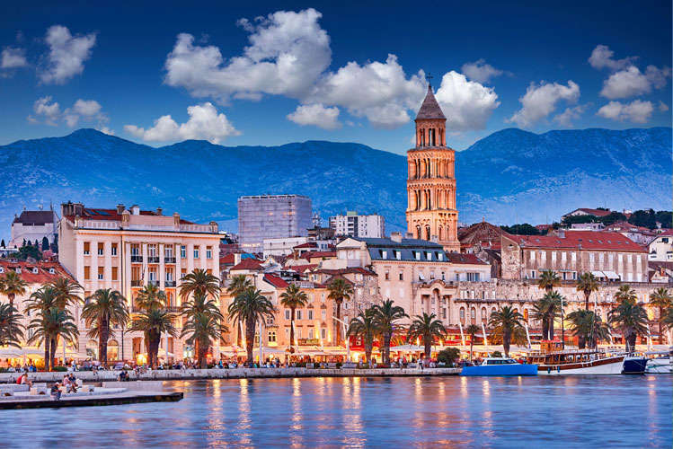
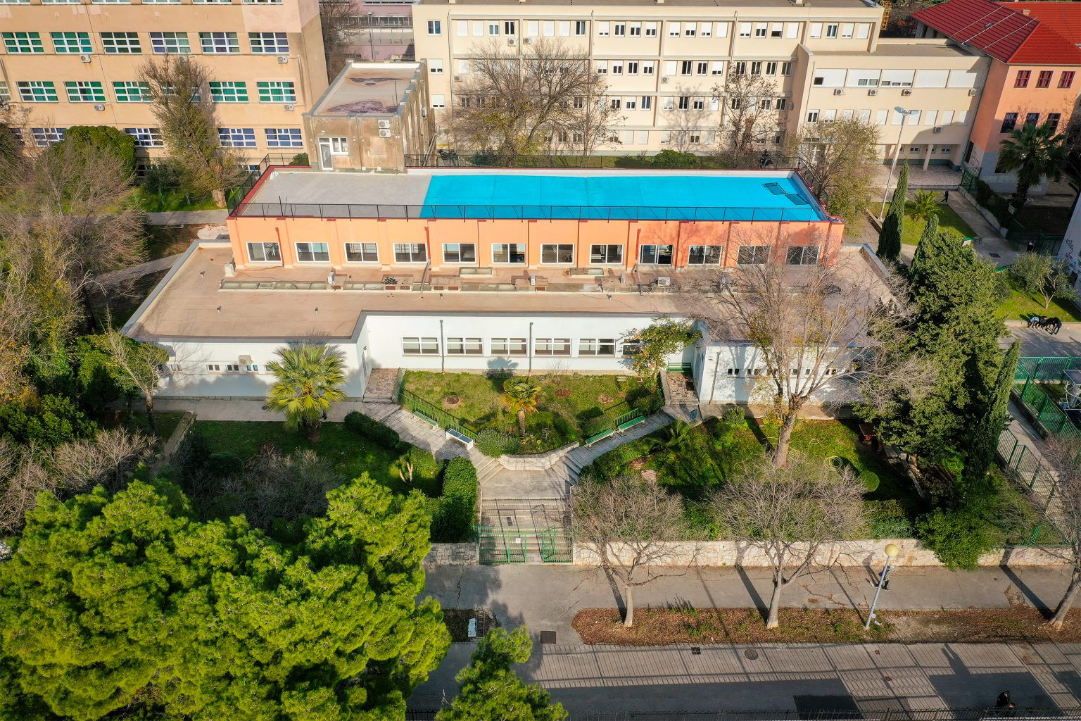
barbara.gilic@kifst.eu

Slide 26
OUR REFERENCES (SOME OF THEM..)
Gilic, B., Sekulic, D., Munoz, M. M., Jaunig, J., & Carl, J. (2025). Translation, cultural adaptation, and psychometric properties of the Perceived Physical Literacy Questionnaire (PPLQ) for adults in Southeastern Europe. Journal of Public Health, 1-11.
Majić, B., Gilic, B., Ajduk-Kurtović, M., Brekalo, M., & Šajber, D. (2024). Physical Literacy Levels in the Croatian Adult Population; Gender Differences and Associations with Participation in Organized Physical Activity. Sport Mont, 22(2), Ahead of Print. doi: 10.26773/smj.240705
Rajkovic Vuletic, P., Gilic, B., Zenic, N., Pavlinovic, V., Kesic, M. G., Idrizovic, K., ... & Sekulic, D. (2024). Analyzing the Associations between Facets of Physical Literacy, Physical Fitness, and Physical Activity Levels: Gender-and Age-Specific Cross-Sectional Study in Preadolescent Children. Education sciences, 14(4), 391. https://doi.org/10.3390/educsci14040391
Miljanovic Damjanovic, V., Obradovic Salcin, L., Ostojic, D., Ostojic, L., Gilic, B., Geets Kesic, M., Uzicanin, E., & Sekulic, D. (2024). Exploring Factors Associated with Physical Activity in the Elderly: A Cross-Sectional Study during the COVID-19 Pandemic. Behavioral Sciences, 14(1), 62. https://doi.org/10.3390/bs14010062
Gilic, B., Sunda, M., Versic, S., Modric, T., Olujic, D., & Sekulic, D. (2023). Effectiveness of Physical-Literacy-Based Online Education on Indices of Physical Fitness in High-School Adolescents: Intervention Study during the COVID-19 Pandemic Period. Children, 10(10), 1666. http://dx.doi.org/10.3390/children10101666
Rajkovic-Vuletic, P., Geets-Kesic, M., Gilic, B., Pehar, M., Uzicanin, E., Idrizovic, K., & Sekulic, D. (2023). Evaluation of Physical Literacy in 9- to 11-Year-Old Children: Reliability and Validity of Two Measurement Tools in Three Southeastern European Countries. Children, 10(11), 1722. http://dx.doi.org/10.3390/children10111722
Sunda, M., Gilic, B., Vuletic, P. R., Pavlinovic, V., & Zenic, N. (2023). Mediating Effects of the COVID-19 Pandemic on the Associations between Physical Activity and Physical Fitness; Cross-Sectional Study among High School Adolescents. Journal of Functional Morphology and Kinesiology, 8(3), 131. https://www.mdpi.com/2411-5142/8/3/131
Geets-Kesić, M., Maras, N., & Gilić, B. (2023) Analysis of the Association Between Health Literacy, Physical Literacy, and Scholastic Achievement; A Preliminary Cross-Sectional Study Among High-School Students From Southern Croatia. Montenegrin Journal of Sports Science and Medicine, 19(1), Ahead of print. https://doi.org/10.26773/mjssm.230301
Gilic, B., Malovic, P., Sunda, M., Maras, N., & Zenic, N. (2022). Adolescents with Higher Cognitive and Affective Domains of Physical Literacy Possess Better Physical Fitness: The Importance of Developing the Concept of Physical Literacy in High Schools. Children, 9(6), 796. Q2 http://dx.doi.org/10.3390/children906079
Sunda, M., Gilic, B., Sekulic, D., Matic, R., Drid, P., Alexe, D. I., Cucui, G. G. (2022). Out-of-School Sports Participation Is Positively Associated with Physical Literacy, but What about Physical Education? A Cross-Sectional Gender-Stratified Analysis during the COVID-19 Pandemic among High-School Adolescents. Children, 9(5), 753. http://dx.doi.org/10.3390/children9050753
Gilić, B., Zenić, N., Separović, V., Jurčev Savičević, A., Sekulić, D. (2021). Evidencing the influence of prepandemic sports participation and substance misuse on physical activity during the COVID-19 lockdown: a prospective analysis among older adolescents. International Journal of Occupational Medicine and Environmental Health. 34(2):151-163 Q4 https://doi.org/10.13075/ijomeh.1896.01733

